Slide 1
Global Performance Dashboard: Test and Learn User Guide
Oct 2024

Slide 2
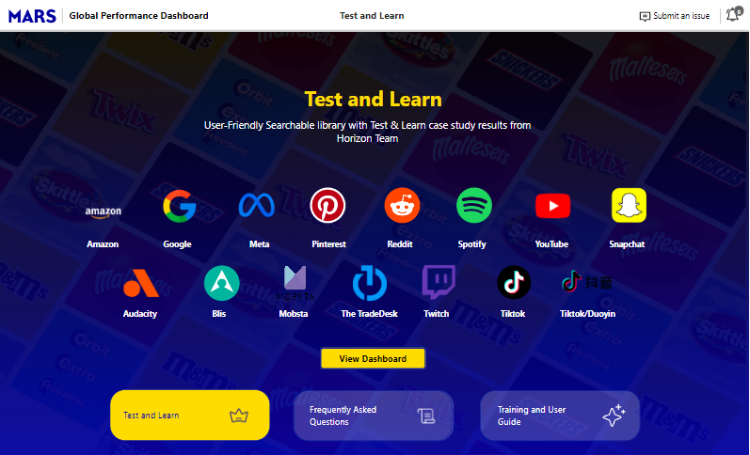
Test and Learn Overview
A test and learn dashboard is user friendly searchable library with Test & Learn case study results from Horizon team
Test and Learn provides ability to search test & learn campaigns across Media 2025, Audience ,Brand, Channel, Partner etc. and see campaign reports by clicking on case links
Performance Metrics such as NSV ROI, Sales Lift and INC Sales Lift are shown based on filter selection

Slide 3
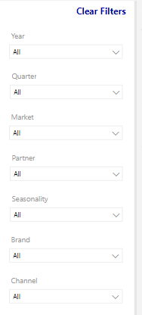
Dashboard Overview
Click on Notification icon to get latest updates on any dashboard/data defects
Provide information to report any issues on dashboard
Help icon is used to get information about any visual in current screen
Clear Filters allows you to revert the filters applied back to default state
Select one or more filters that will restrict data on report based on the selection

Slide 4
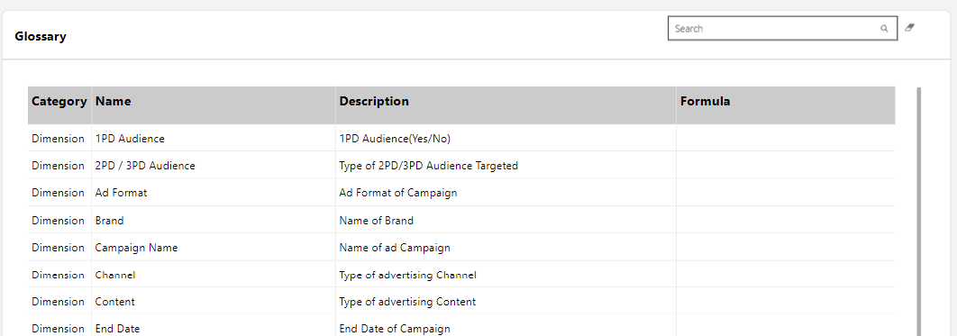
Dashboard Overview
Glossary provides the description and formulas for all the dimensions and metrics present in the dashboard
Metrics / Dimensions can be searched here and erase icon at the right end of search bar can be used to clear the text entered in search bar

Slide 5
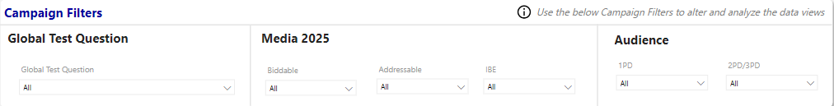
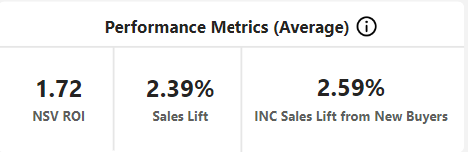
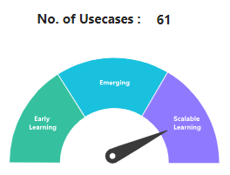
Test and Learn
Use these Filters to filter the report as per Global Test Question, Media 2025 and Audience attributes
This section shows the Average Performance Metrics(NSV ROI, Sales Lift, INC Sales Lift) based on filter selection
This Gauge chart shows the category (Early Learning, Emerging, Scalable Learning) based on No. of Use cases after filter selection

Slide 6
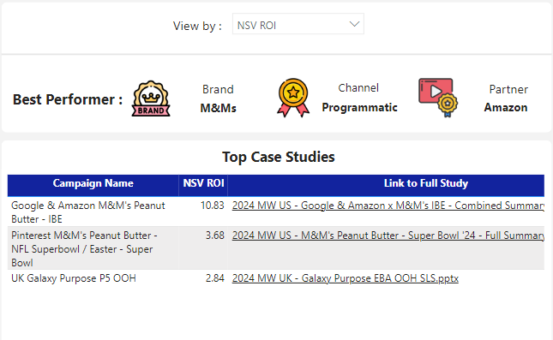
Test and Learn
This section shows the Best Performers based on selected Performance Metric(NSV ROI/Sales Lift/INC Sales Lift) across Brand , Channel and Partner
Table shows top case studies based on selected KPI in dropdown

Slide 7
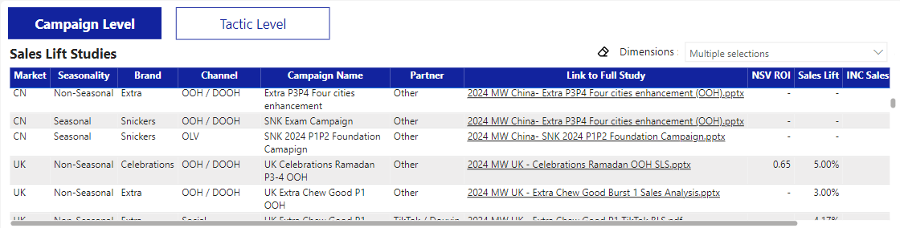
Test and Learn
Switch between Campaign Level and Tactic Level data
Filter in/out dimensions needed in the table and use the icon to clear the selections to default
This table is used to show the Performance Metrics (NSV ROI/Sales Lift/INC Sales Lift) )data at both Campaign and Tactic Level attributes

